Slide 1
Evolution Sunday
Notes:
Some slides to help with evolution Sunday (written in 2011, but useful any year).
There is an accompanying text document at http://ecofaith.org/evolutionsunday with the all ages talk, reflection etc.
I’ve left you to insert whatever songs you like; the notices; intercession etc
Use and modify whatever you like, with acknowledgement of Rev Dr Jason John , Mid North Coast Uniting Church EcoMinistry

Slide 2
Notes:
Welcome
Continue to think about maps and landmarks.
Keeping the maps up to date so we can make sense of the landmarks like love God HMSS & neighbour as ourself as our world changes.
Image:Leunig

Slide 3
Notes:
Confession with thanks to Leunig
(pause each line)
God of the universe
Of the earth
Of us
You are welcome here
Thanks for your presence, may we all have the eyes and ears to see and hear it.
God help us to change
To change ourselves and to change our world
To know the need for it
To deal with teh pain of it
To feel the joy of it
To undertake teh journey without understanding the destination
Teh art of gentle revolution
Amen.

Slide 5
Matt 5:21 (sermon on the mount cont), paraphrased
The bible says, 'You shall not murder'; (exodus 20:13) But I say to you...
RESPECT OTHERS, APOLOGISE
The bible says, 'You shall not commit adultery.' (Exodus 20:14) But I say to you....
FOCUS ON YOUR SPOUSE
The bible says, 'Whoever divorces his wife, let him give her a certificate of divorce.' (Deut 24:1 paraphrase) But I say to you ...
CARE FOR YOUR WIFE
The bible says, 'An eye for an eye and a tooth for a tooth.' (Exodus 21:24, Leviticus 24:20, Deuteronomy 19:21) But I say to you...
FORGIVE. GIVE FREELY.
The bible says, 'You shall love your neighbour (Lev 19:19) and hate your enemy .(frequent allusions) ' But I say to you...
LOVE THEM, BECAUSE GOD DOES
Again the bible says, 'You shall not swear falsely (Lev 19:12) , but carry out the vows you have made to the Lord.' But I say to you... Let your word be Yes or No. Vows to the lord come from the evil one.
SAY WHAT YOU MEAN, AND DO IT
Notes:
Reading Paraphrase of Matt 5:21

Slide 6
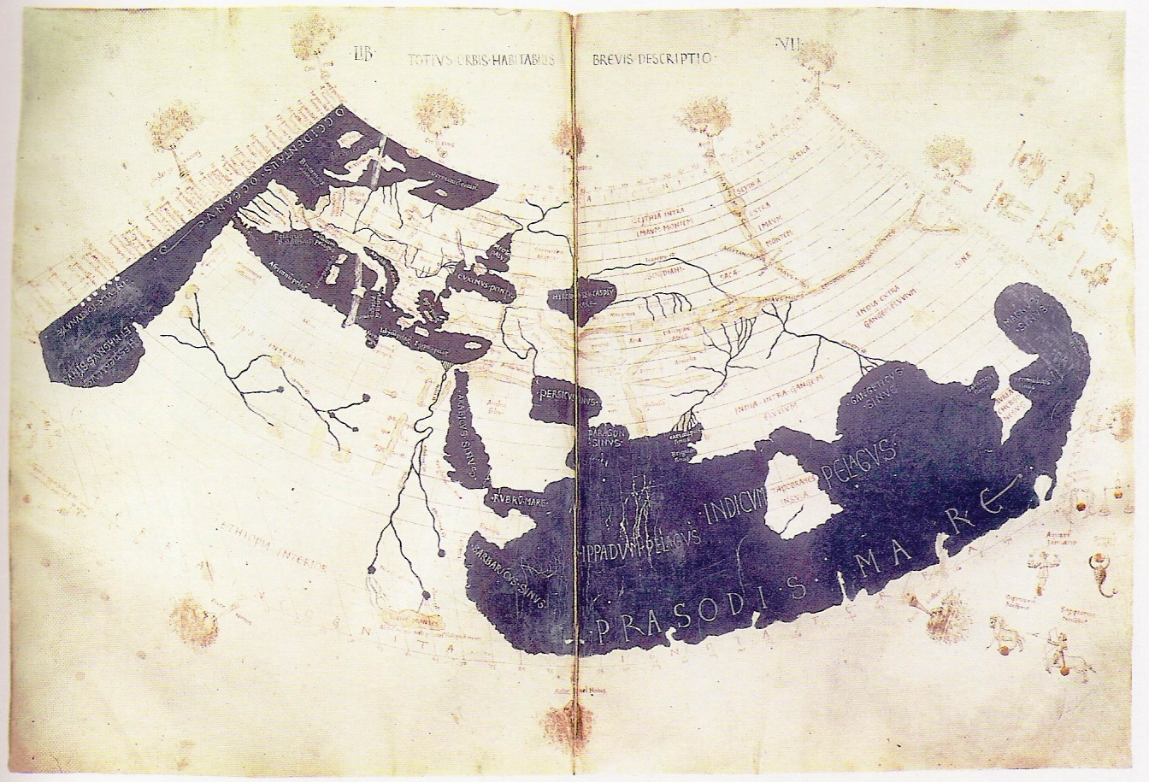
Notes:
The bible says but I say (maps)
In January I talked about the metaphor of the bible as a map. Although some landmarks stay the same, maps can get out of date. Jesus came and reminded people to focus on the landmarks: love God with all your heart, mind, soul and strength, and your neighbour as yourself.
And as we see in today’s reading, that meant changing the map. So much that the disciples were often quite confused and had to rely on Jesus to guide and teach them.
You have heard it said (and its in the scriptures) ... but I say to you...
If we know the landmarks, then we can move into previously uncharted territory, and we can adjust the map when necessary, especially as we have the Spirit of god to help guide us on the way.
Which is lucky, since the world has changed a lot since Jesus’ day as well, so even his map needs updating as we try to love the lord our God with all our HMSS.
Even the actual map has changed (on slide): here’s what people thought the world looked like in Jesus day. Notice we’re not even on it. But some is a bit the same: Europe, Jesus town.
What other similarities and differences can we think of between Jesus’ world and ours?
(we can watch the whole world on the news, where more women have more rights and money, but the gap between the richest and the poorest is even bigger? Where humans have spread over the whole world, where we have in vitro fertilisation, life support, interest on loans?)
One in our reading today: Before Jesus time divorce was ok. Then Jesus said it wasn’t. Now in our church we say it is.
That seems weird.
But it’s because the map has changed.
In the OT men were allowed to divorce their wives (not the other way around). But women couldn’t get a job, or own property. So if the man dumped them, they were penniless. Jesus said that was wrong: its not loving your neighbour to throw your wife out on the street. Even being in a terrible marriage was probably better than being thrown out and starving or ending up someone’s slave.
Now women can earn money, and own property, and can speak in public, and have friends, and we look after each other at least a little better than back then, so we think the most loving attitude towards men and women is to accept that sometimes their marriage doesn’t work out, and let them separate. But if they do, they can’t leave each other broke, and they have to make sure they look after the children.
So to follow Jesus’ landmark, we’ve updated the map.
One more, where I think we would stick with Jesus’ map, because our world is still like his in many ways;
The bible said: don’t murder. Easy enough for most of us. But Jesus said, if I’m understanding him right, that to seethe with anger and want the worst for someone is also wrong. And if we stoop to insulting them or calling them names then we show that we’ve failed to love them, we’re not following Jesus path anymore. If we dismiss them as stupid fools we’ve wandered far from the Way of Christ.
Talk about the evolution of life later. Other people believe that the world was created in six days. According to Jesus’ teaching on anger and judgment here, being a Christian isn’t about being a creationist, or an evolutionist. We know whether we’re following Jesus’ path by how we respond to, and feel towards, and say about, those who disagree with us.
When we disagree about divorce, or money, or evolution, or euthanasia or any of the ways that we try to live out our faith in a new world, we need to remember this sermon on the mount.
We need to help each other as companions on the road of faith together.
And we can do it! Each of us, each of you, has a line of ancestors going way, way, way back into time: not just thousands, or millions, but billions of years. And every one of your ancestors survived. You come from a looooong line of survivors, we all do. And especially recently, that long line of ancestors survived because they learned to help each other. To travel together and serve each other. To love each other. To do for each other as they would want the others to do for them. In other words, to follow Jesus’ landmarks.
Our ancestors survived by being able to cooperate together, to be on mission together, amidst their disagreements.
Let’s sing our commitment to each other in this adventure as we collect the offering.

Slide 7
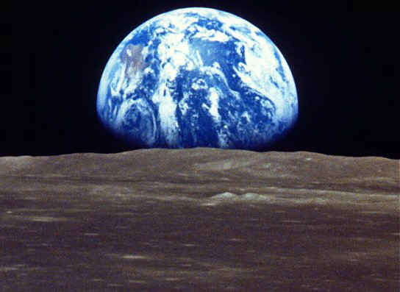
Notes:
Introduction and evolutionists genesis 2011 version (both in the associated .doc file)

Slide 8
Notes:
Intro to reading:
If you have no interest in the good news to be uncovered in the story of evolution, then you can spend the next 10 minutes or so reflecting on what Jesus “but i say” monologue means for you, and what you would say as you try to follow his landmarks in the 21C.

Slide 9
"You have heard that it was said to those of ancient times, 'You shall not murder'; and 'whoever murders shall be liable to judgment.' But I say to you that if you are angry with a brother or sister, you will be liable to judgment; and if you insult a brother or sister, you will be liable to the council; and if you say, 'You fool,' you will be liable to the hell of fire.
So when you are offering your gift at the altar, if you remember that your brother or sister has something against you, leave your gift there before the altar and go; first be reconciled to your brother or sister, and then come and offer your gift. Come to terms quickly with your accuser while you are on the way to court with him, or your accuser may hand you over to the judge, and the judge to the guard, and you will be thrown into prison. Truly I tell you, you will never get out until you have paid the last penny.

Slide 10
"You have heard that it was said, 'You shall not commit adultery.' But I say to you that everyone who looks at a woman with lust has already committed adultery with her in his heart. If your right eye causes you to sin, tear it out and throw it away; it is better for you to lose one of your members than for your whole body to be thrown into hell. And if your right hand causes you to sin, cut it off and throw it away; it is better for you to lose one of your members than for your whole body to go into hell.
"It was also said, 'Whoever divorces his wife, let him give her a certificate of divorce.' But I say to you that anyone who divorces his wife, except on the ground of unchastity, causes her to commit adultery; and whoever marries a divorced woman commits adultery.

Slide 11
"You have heard that it was said, 'An eye for an eye and a tooth for a tooth.' But I say to you...
"You have heard that it was said, 'You shall love your neighbour and hate your enemy.' But I say to you...
"Again, you have heard that it was said to those of ancient times, 'You shall not swear falsely, but carry out the vows you have made to the Lord.' But I say to you, Do not swear at all, either by heaven, for it is the throne of God, or by the earth, for it is his footstool, or by Jerusalem, for it is the city of the great King. And do not swear by your head, for you cannot make one hair white or black.
Let your word be 'Yes, Yes' or 'No, No'; anything more than this comes from the evil one.

Slide 12
reflection

Slide 13
Notes:
Blessing
Pain and death are not humanities fault.
If creation is falling into calamity we can do something about it.
We are the latest in an unbroken line of survivors, still aided by our ancestors, yet enabled by the Spirit not to cave into them. Not to blindly follow their maps in our lives.
All these things should give us joy.
Culminating in the joy of knowing that we are loved by this God who is beyond our comprehension, seen in Jesus, and known within and amongst us.
So let’s go in the love of God, on the Way of Jesus, in our day.

Slide 14
May the kindness of our Lord Jesus
And the love of our God
And the friendship
And the unity
Of the Spirit be with us- be with us.
Andrew Dutney
Notes:
If you can track this song down I highly recommend it, great tune

